Slide 1

Green Pace Security Policy
Ethan Chapman
CS-405
Professor Mills

Slide 2

Overview of Security Policy
• Standardizes secure development practices • Reduces attack surface area • Assumes vulnerability, not safety • Supports defense-in-depth strategy • Aligns coding standards with security principles
(NIST, 2020)

Slide 3

Threat Matrix Summary
*Risk ranking methodology adapted from NIST SP 800-53 (NIST, 2020)
Standard | Severity | Likelihood | Priority | Level
STD-004-CPP | Critical | High | Critical | 5
STD-005-CPP | Critical | Medium | High | 5
STD-008-CPP | Critical | Medium | High | 5
STD-002-CPP | High | High | High | 5
STD-003-CPP | High | High | High | 5

Slide 4


Automation for Detection
Static Analysis (SAST) • SonarQube • Cppcheck • Clang-Tidy
Dynamic Analysis • AddressSanitizer • Valgrind

Slide 5

Ten Core Security Principles
Validate Input Data
Heed Compiler Warnings
Design for Security
Keep It Simple
Default Deny
Least Privilege
Sanitize External Data
Defense in Depth
Quality Assurance
Secure Coding Standards
*Based on ISO/IEC 27001 and NIST principles (ISO/IEC, 2014; NIST, 2020)

Slide 6

Mapping Principles to Standards
• STD-002 → Principle 1 (Validate Input) • STD-004 → Principles 1, 7, 8 • STD-005 → Principles 6, 8, 10 • STD-008 → Principles 6, 10 • STD-010 → Principles 3, 5

Slide 7

Coding Standards Prioritized
SQL Injection (STD-004)
Memory Protection (STD-005)
Pointer Safety (STD-008)
Input Validation (STD-002)
String Safety (STD-003)
Logging (STD-010)
Data Types (STD-001)
Assertions (STD-006)
Exceptions (STD-007)
Resource Management (STD-009)

Slide 8

Encryption Strategy
Encryption at Rest • AES-256 • Protects stored data
Encryption in Flight • TLS 1.2+ • Protects transmitted data
Encryption in Use • Memory protections • Minimizes runtime exposure

Slide 9

Triple-A Framework
Authentication • Secure password hashing • Multi-factor authentication
Authorization • Role-Based Access Control • Least privilege
Accounting • Logins • Database changes • File access • Permission changes

Slide 10
Unit Testing: Input Validation
• Test invalid age input • Verify rejection of out-of-range values • Use Visual Studio C++ unit test framework • Can expand to fuzz testing

Slide 11
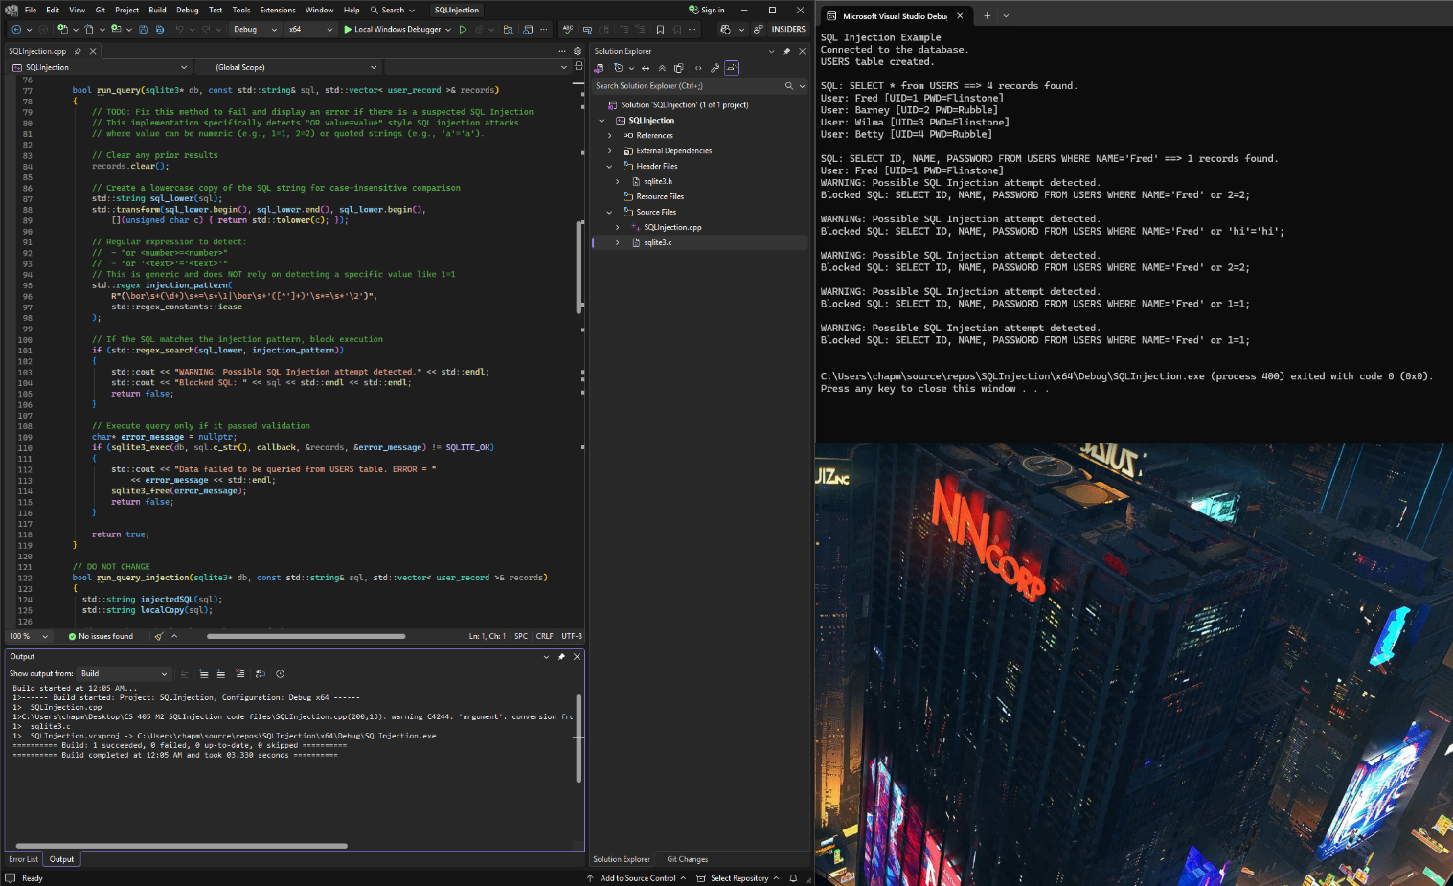
Unit Testing: SQL Injection
• Test parameterized queries • Verify input cannot alter SQL structure • Simulate malicious input attempts • Expand to penetration testing

Slide 12
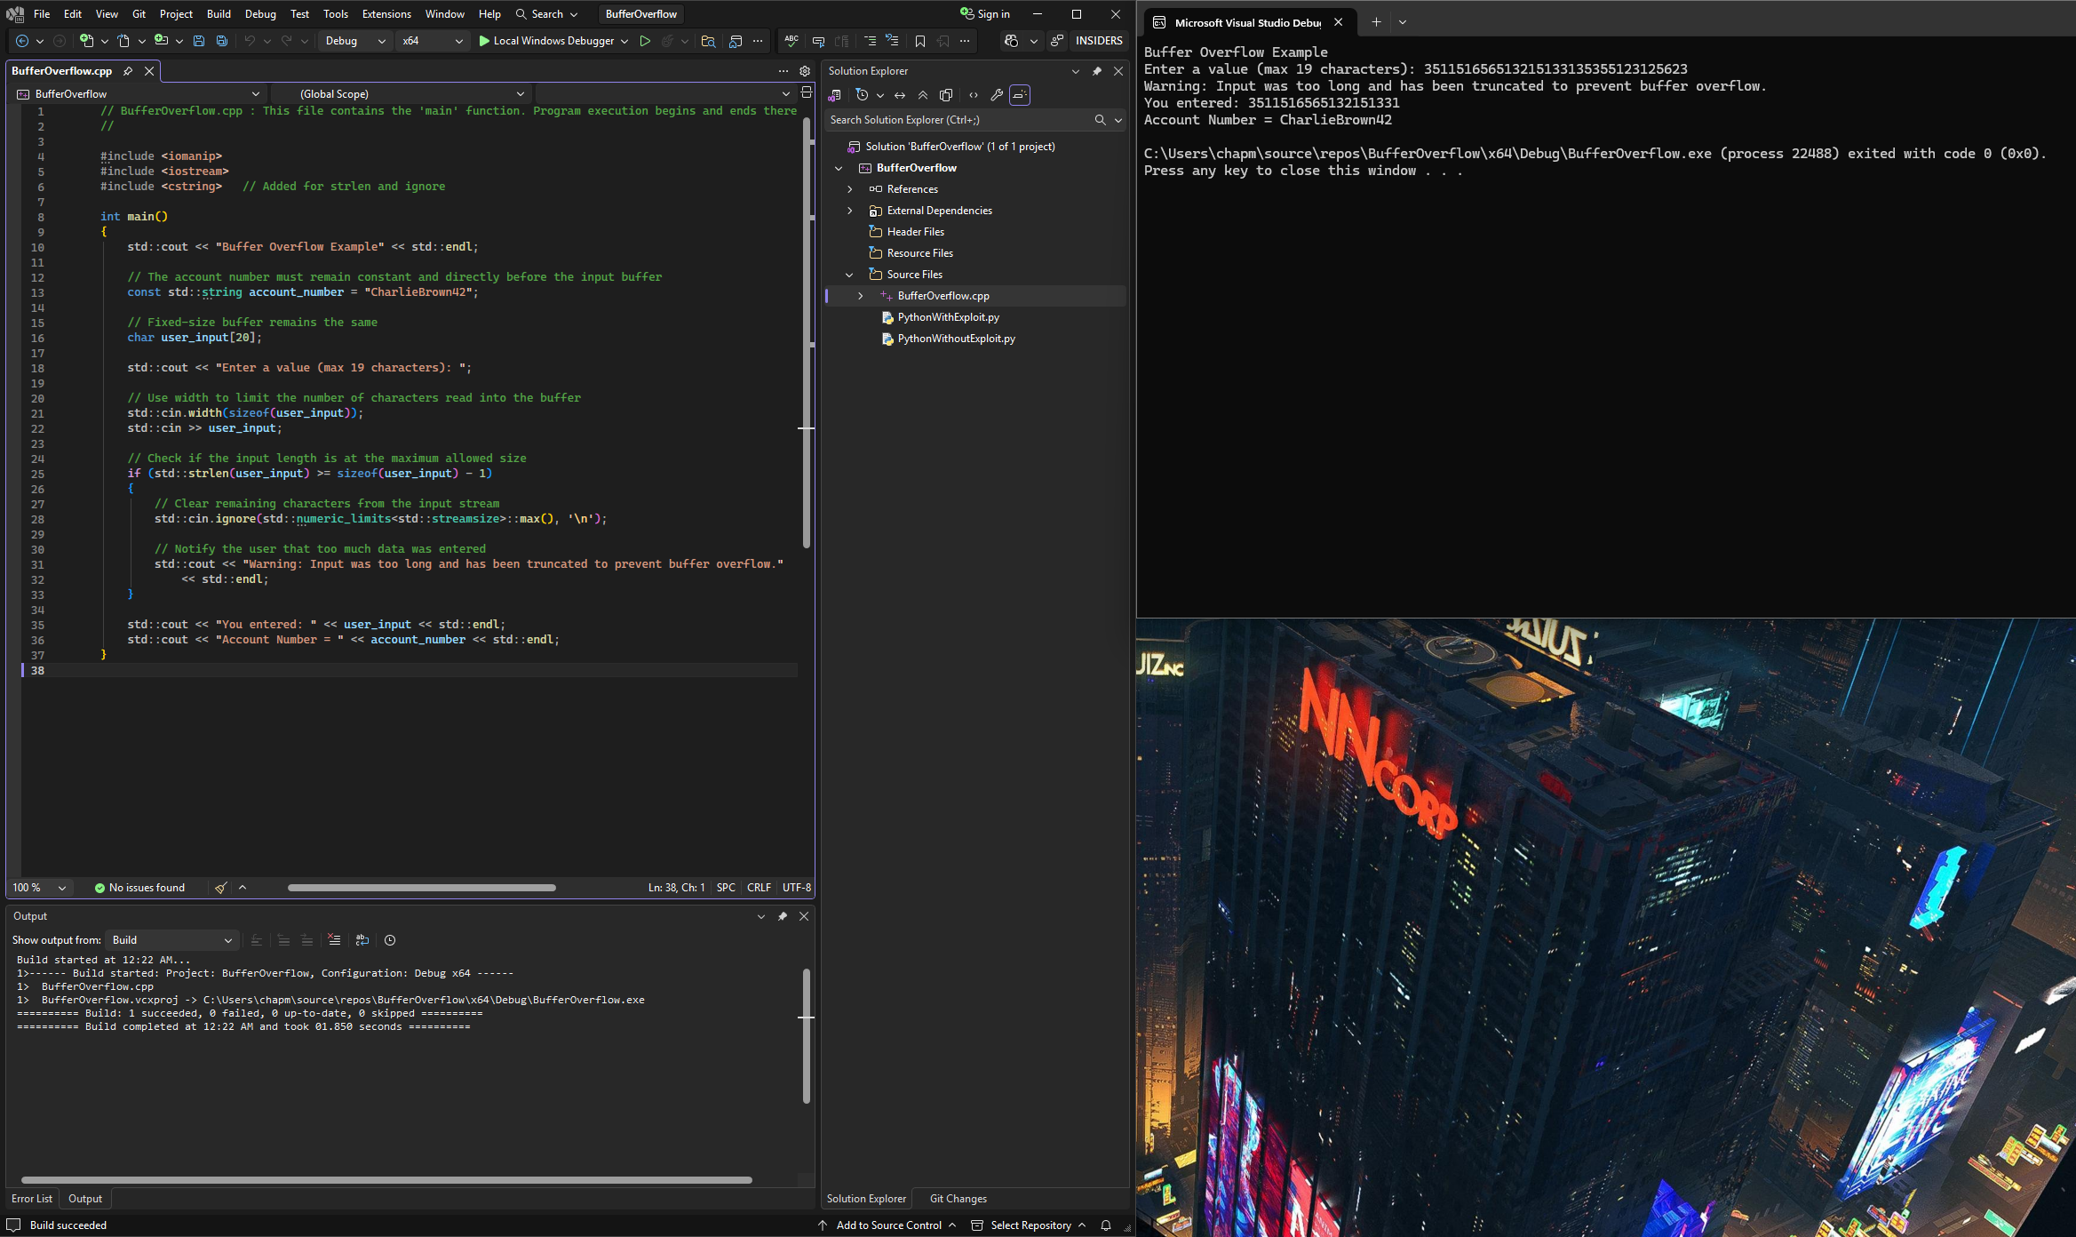
Unit Testing: Memory Safety
• Detect out-of-bounds access • Validate pointer initialization • Use AddressSanitizer during testing • Prevent runtime crashes

Slide 13
DevSecOps Automation Flow
Code
Build
Test
Deploy
Operate
SAST scanning
Compiler warnings treated as errors
Unit tests + dynamic analysis
Compliance gates
Log monitoring

Slide 14

Risks and Benefits
If We Act Now • Reduced breach risk • Lower remediation cost • Regulatory compliance
If We Wait • Increased exploit probability • Higher financial loss • Reputation damage

Slide 15

Future Policy Improvements
• Dependency vulnerability scanning • Container security analysis • Continuous penetration testing • Secure SDLC training • Zero Trust architecture adoption

Slide 16
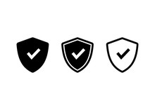
Conclusion
• Security integrated across development lifecycle • Automation reduces human error • Layered controls support defense-in-depth • Continuous improvement required

Slide 17
References
Carnegie Mellon University, Software Engineering Institute. (2016). SEI CERT C++ coding standard. https://wiki.sei.cmu.edu/confluence/display/cplusplus
National Institute of Standards and Technology. (2020). Security and privacy controls for information systems and organizations (NIST SP 800-53 Rev. 5). https://doi.org/10.6028/NIST.SP.800-53r5
OWASP Foundation. (2021). OWASP top 10: The ten most critical web application security risks. https://owasp.org/www-project-top-ten/
Microsoft. (2023). AddressSanitizer for MSVC. Microsoft Learn. https://learn.microsoft.com/en-us/cpp/sanitizers/
ISO/IEC. (2014). ISO/IEC 27001: Information security management systems. International Organization for Standardization.

